Slide 1
Introducing the Initiative
Q4 2021

Slide 2
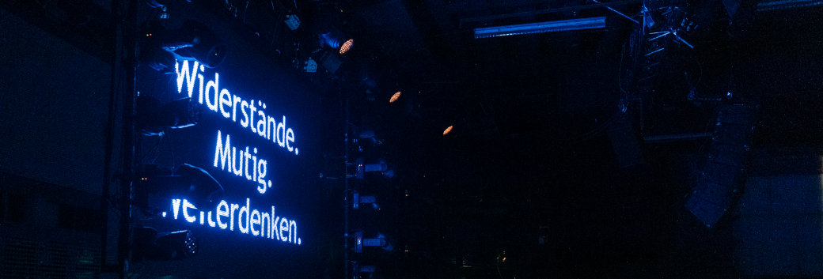
Our
vision
A world in which JOBLINGE is no longer needed, because young people can build their futures without having to overcome the hurdles of their past
Our mission
JOBLINGE boldly confronts these hurdles by
  enabling young people—no matter what their background—to recognize their potential and earn their own apprenticeship or job,
  forging new paths to success for participants and measuring itself on the initiative's impact, and
  mobilizing and bundling the greatest strengths of government, business, and civil society to these ends

Slide 3
Why we (still) need JOBLINGE
How does JOBLINGE work? Key success factors of the program
A strong network for the youth—be part of it

Slide 4
Apprenticeships and labour market in Germany during the pandemic: Generation Corona?
„
„
Corona crisis as an opportunity for the digitalization of our lives
focus, 3/16/2020
Due to Corona pandemic: Trainees and
businesses in waiting mode
DLF, 3/27/2020
„
„
„
Corona crisis leads to historical decline
for the apprenticeship market
Handelsblatt, 12/15/2020
Trainees:
The forgotten victims
of the Corona crisis
DLF, 5/26/2020
„
Apprenticeship market in the pandemic: Twelve percent fewer trainees
Tagesschau, 12/15/2020
„
Youth unemployment in
Berlin rises by 44 percent
Tagesspiegel, 12/02/2020
„
Apprenticeship during Corona:
A lost generation?
FAZ, 8/18/2020
„
Will there be 50,000 fewer
apprenticeships due to Corona?
Handelsblatt, 7/26/2020
Low-income and Hartz IV recipients suffer particularly from Corona crisis
Focus, 10/20/2020

Slide 5

The Corona crisis changes our society
Due to the Corona crisis we are suddenly on a fast track towards a digital future. In emerging working environments digital competences will become even more relevant for our professional future.
It is now crucial not to leave the young people alone but to give them the confidence to continue learning for their professional future.

Slide 6
… particularly underprivileged youths have bleak vocational prospects
Although the demand for workers remains unmet, …
5M
75%
2.1M
Shortage of
skilled workers by 2025
forecasted¹
of German
companies see shortage of young talent as
the biggest risk²
Young people under the age of 34 are without a vocational qualification³
2019 first reduction in the number of unfilled vacant training positions (K)³
Another
500,000
youths without
professional prospects
+8%
200,000 people under the age of 25 are unemployed⁴
300,000 are in measures of the so-called “transition system”
2013
2014
2015
2016
2017
2018
2019
1. Boston Consulting Group 2. Commerzbank SME report 3. Berufsbildungsbericht der Bundesregierung (2014–2019) 4. Statista

Slide 7

JOBLINGE closes the gap between background and future
A strong network of business, government, and private individuals.
Joining forces to create opportunity.

Slide 8
Our participants: JOBLINGE helps almost 2,000 young people to find a job every year
Classic program
for youth in the
transitional system
Kompass program
for young refugees
Age
15–27
15–27
Education
Over 42% have a lower secondary degree (at the most)
Low to medium qualifications
Background
57% with
migration background
Syria, Eritrea, Iraq,
Afghanistan, Iran, etc.
Gender
66% male
79% male
Social needs
> 70% are part of a household on welfare and have been in the transitional system for an average of 3 years
Refugees with residence
permit or temporary permission to stay

Slide 9
We bring apprentices and companies together
Average placement
Hands-on career guidance
Strengthening of personality and professional competences
Tailored qualification and placement
Supporting for both parties—company and trainee—till the end of the apprenticeship
75%
~ 20%
Other programs with the same target group
84%
Sustainability

Slide 10
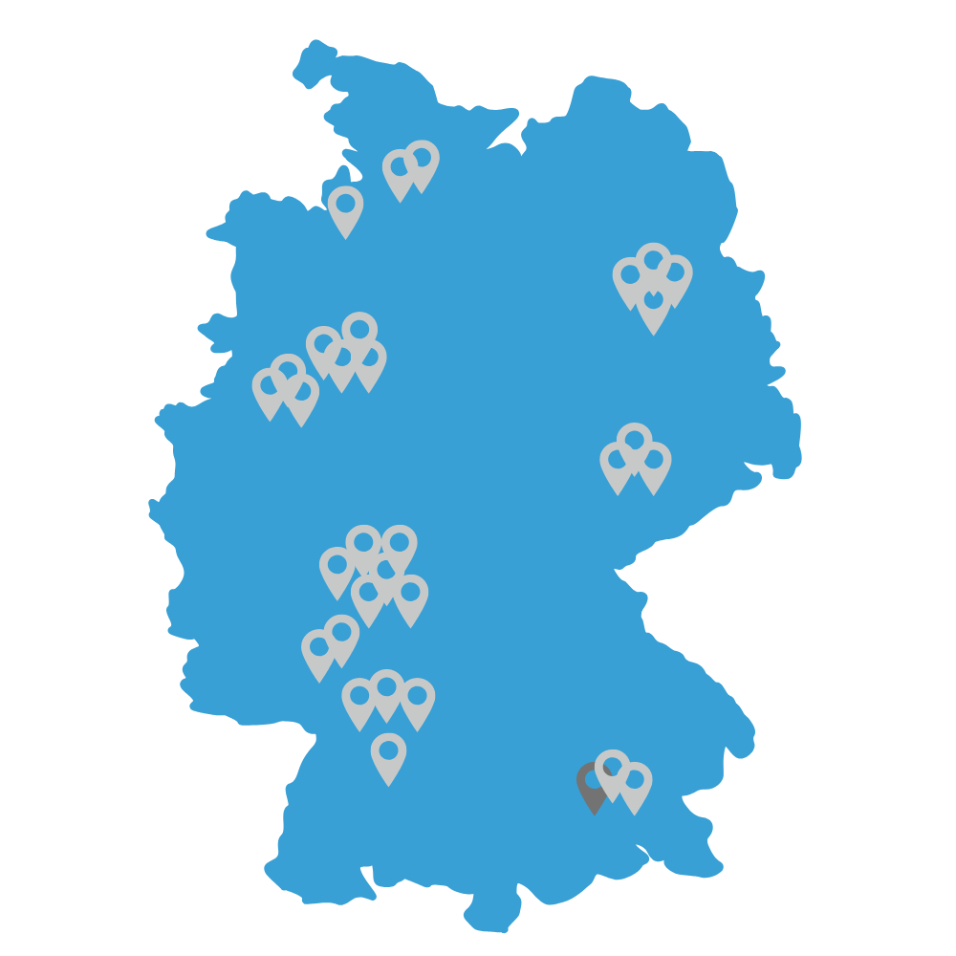



JOBLINGE is active in over 30 locations in Germany
Hamburg
Hamburg Kompass
Bremen
Essen
Gelsenkirchen
Recklinghausen
Ruhr Kompass
Pankow
Spandau
Schöneberg
Friedrichshain
Hanse gAG
Ruhr gAG
Berlin gAG
Cologne
Cologne Kompass
Troisdorf
Leipzig
Leipzig Kompass
Halle (Saale)
Rhineland gAG
Leipzig gAG
Frankfurt-RhineMain gAG
Frankfurt
Frankfurt Kompass
Darmstadt
Offenbach
Mainz
Wiesbaden
Ludwigshafen
Rhine-Neckar county
Rhine-Neckar Metro Region gAG
Stuttgart Region
gAG
Stuttgart
Stuttgart Kompass
Pforzheim
Reutlingen
Munich gAG
Munich
Munich Kompass

Slide 11
You need to try the impossible to attain the possible—that's been my motto ever since
JOBLINGE changed my life.
Firaas Alkhaliefa, former participant from Stuttgart.
After successfully completing his apprenticeship, he is going on for further training to become an industrial foreman
“

Slide 12
Why we (still) need JOBLINGE
How does JOBLINGE work? Key success factors of the program
A strong network for the youth—be part of it

Slide 13
The success of the JOBLINGE program is based on four pillars
Practical experience
from day one
One-on-one support
from mentors
Consolidated
local commitment
Entrepreneurial
approach

Slide 14
Practical experience from day one
The program: Intensive preparation for the work world in six months
2 weeks*
~ 6 weeks
~ 17 weeks
+6 months
Approx. 3 years
Introduction/
admission
Orientation
Practice
Qualification
and work
Apprenticeship
Support of participants by mentors
Motivation check and creating the participant groups
Job skills
Testing occupations in practice
Language course at company
Comprehensive mentoring and support
from experts in on-the-job support
Practical vocational orientation in and with companies
Practical vocational orientation in and with companies
STEM program, culture and activity programs, group projects, and individual support
One year of work
MILESTONES
Applied at JOBLINGE
Accepted to JOBLINGE
Target vocation found
Gained Job skills
Employment/apprenticeship contract received
Element of Kompass program for refugees
4 groups of approx. 20 participants start every year
* Precedes official JOBLINGE program—participation voluntary; admission phase not compensated by public agencies

Slide 15
Practical experience from day one
Now also digital: Our virtual JOBLINGE program
Regional differences according to the current legal situation.
Introduction/
admission
Orientation
Practice
Apprenticeship
  Personal advice & support via (video) calls
Virtual classroom with digital curricula
Digital learning opportunities (e.g. "Mathe als Mission")
Videoconferencing & Webinars
Personal support via (video) calls
Learning path development together with companies
Personal support via (video) calls by JOBLINGE employees
Digital learning opportunities
“Help Hotline" for trainees and trainers
Intensification of relationship model with corporate partners
Communication platform for youth / JOBLINGE
*Participants accompanied by mentors via video calls
Current development of further digital modules such as digital recruitment, expansion of learning platforms to training support

Slide 16
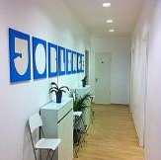


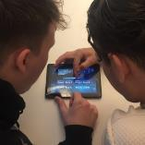
Venture instead of lecture
Practical experience from day one
JOBLINGE location
Professional environment, dress code, formal form of addressing people, working as equals, rapport building, and initiating a change process
Companies
Workshops with/at partner businesses: Practicing small talk or interviews, getting to know vocations and companies, preparing and starting an internship
    Cultural program
    Getting out of the comfort zone with dance, theater, and art: Being open to new things and overcoming personal limitations—experiencing success, exuding presence, and personality
STEM program
Digital learning and
hands-on experience—
via an app and work-
shops fit for the
world of work 4.0
Developing professional skills—at places of learning that prepare program participants for an apprenticeship

Slide 17
Target-oriented, not an endless loop:
Mentoring at JOBLINGE
One-on-one mentoring
Our mentors
have professional and life experience,
serve as a confidant and coach,
encourage and motivate,
listen, ask follow-up questions—and are there
when it matters
The framework
Professional preparation and support from JOBLINGE
Clear timeline for volunteers: beginning and end
Clearly defined role and definition
Mentor training and regular get-togethers to talk about experience
Working in tandem
One-on-one mentoring of "my" mentee throughout the program
4–6 months for around 2 hours per week
Advise and help in career guidance, during internship, in dealing with superiors or colleagues, or private issues
Common goal
Apprenticeship contract
www.joblinge.de/mentoring

Slide 18

We know that personal networks are the biggest sources of procuring a job in Germany.
People with no network have a harder time finding a job.
Heinrich Alt, former CEO of the
Federal Employment Agency
Bundled commitment
“
Private sector
Public sector
Foundations
Cultural institutions
Volunteers
Athletic clubs
Other initiatives/
nonprofit organizations

Slide 19
“
Trust thrives on professionalism and good collabouration. JOBLINGE works closely with our company; positive feedback came quickly, and we were motivated in saying, "Let's do more and explore new paths." I see us together as bridge builders.
Dirk Heyden, Director of the Hamburg job center
“
Our junior players take advantage of JOBLINGE's offer. Having a plan B is never a bad idea. And with JOBLINGE, our players are also not alone in that field—they receive support from experts and a big team.
Armin Kraaz, head of development center Eintracht Frankfurt
“
Since 2014, we have had 50 program participants start internships and then be taken on for apprenticeships. The success rate for subsequent acceptance is 80%—that's why we're so convinced of the program and concept.
Peter Bartholomäus, Management InfraServ Wiesbaden
Cooperation, not charity

Slide 20
Our approach: Entrepreneurial thinking for our societal goal
Entrepreneurial approach
Visibility
E.g., annual report, supervisory board meeting, and general assembly
Impact orientation
For the youth and all involved
Goal focus and measurability
+ Innovative spirit
+ Venture mind-set
+ Anticipating labour market trends for the target group—instead of delayed reaction
Best-possible
use of resources
Placement (in apprenticeship or work)
Sustainability (after six months in apprenticeship and after three years/completion of training)
Grants, donations, volunteering

Slide 21


Slide 22
Why we (still) need JOBLINGE
How does JOBLINGE work? Key success factors of the program
A strong network for the youth—be part of it

Slide 23
A strong network for the youth
As of Q1 2020
As of Q4 2021
JOBLINGE Classic
> 10,300
JOBLINGE Kompass
> 2,600
Participants
Companies
> 2,400
Volunteers
> 2,700
Public sponsors
> 50
Locations
30
Employees
250

Slide 24

Shared commitment reflected in financing
Approx. 65% from public sector¹
Approx. 35%
from donations¹
Basic costs for vocational preparation/placement
Standard elements
Personnel and rental costs
Additional program elements: Mentoring, culture and activity, STEM
Apprenticeship support
Further development, new projects, and innovations
Communal shaping rather than singular administering
1. Portion of public financing varies from location to location (between 30% and 90%), umbrella organization with 100% private donations (businesses, foundations, private individuals)

Slide 25
Per Year Classic
Per Year Kompass
+36%
In order to create lasting oppor-tunities for more and more young people, we look forward to having more strong partners join us: as sponsors, for internships and apprenticeships,
and as mentors
1,516
Participants
338
08
09
10
11
12
13
14
15
16
17
18
19
20
21 (FC)
Avg. 75%
Sustainability rate: 84%
Placement rate
09/10
11/12
13/14
15/16
17/18
19/20

Slide 26




Tackling the challenges of the labour market with experience and expertise: Our current projects
Core target group
Other target groups
  Target group of disadvantaged/
  long-term unemployed youth remains
  Complete withdrawal—frequently no longer reached by the job center at all
  Young parents, esp. women, largest group of unemployed
  Almost 40% of single parents receive state transfer payments
  High risk of poverty—continuation
  for children
New ways to recruit and activate
(Single) parents
Digitalization
Apprenticeship support
  Digitalization shaking up labour market
  New requirements of apprentices/
  Workforce 4.0: Social and digital competences
  Strengthening target group and seizing opportunities—giving those a chance who have been left behind
  Shortage of skilled workers and applicants reduces recruitment hurdles
  Difficulties shift to apprenticeship
  Demanding requirements not only for apprentices but also for businesses and trainers
JOBLINGE 4.0
Apprenticeship support and baseC@mp

Slide 27
We want to do more—so we need you
As a mentor
As a company
As a
foundation
As a cultural or athletic institution
From the
public sector
www.joblinge.de/mitmachen

Slide 28


Volunteering: Your options
As a company
As a partner business of the JOBLINGE initiative, you'll provide future prospects for young people. You'll gain apprentices or offer your employees a platform for corporate volunteering. That will give you manifold opportunities to combine community involvement with the needs of your own company.
As a cultural or athletic institution
Workshops and trainings on modern art and classic masterpieces to deal with one's own personality are specially developed in cooperation with institutions from culture and sport. The young people gain access to the institutions, which in turn attain new target groups.
As a private individual
Whether one-on-one as a mentor or trainer for a small group—your volunteer involvement is essential for the success of the JOBLINGE program. With your professional and life experience, you'll support young people in taking control of their own lives.
From the public sector
The JOBLINGE program would not be possible without our strong partners on the municipal, state, federal, and European levels. The public sector not only forwards participants but also is the first point of contact when setting up a new location.
As a foundation
Commitment needs partnerships. What companies contribute as partners offering internships and apprenticeships, foundations supplement with conceptual involvement and know-how. We work together with foundations on targeted projects that are piloted, evaluated, and then rolled out nationwide.

Slide 29
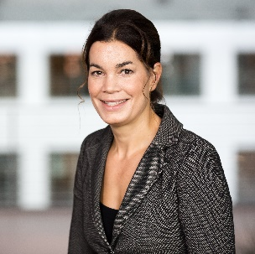







  Contact us—we look forward to hearing from you!
Ansprechpartner bitte anpassen
Ulrike Garanin
Name
Director JOBLINGE Umbrella Organization
Associate Director, Boston Consulting Group
Kapuzinerstr. 9d
80337 Munich
Phone: +49 89 1250 14111
Mobile. +49 170 334 4584
garanin.ulrike@bcg.com
Foto
Address
Phone: +49 XXXX
Mailaddress
Donation account: Recipient: JOBLINGE Stiftung | IBAN: DE68302201900016542466 | BIC: HYVEDEMM414
Please find further information on www.joblinge.de.

Slide 30
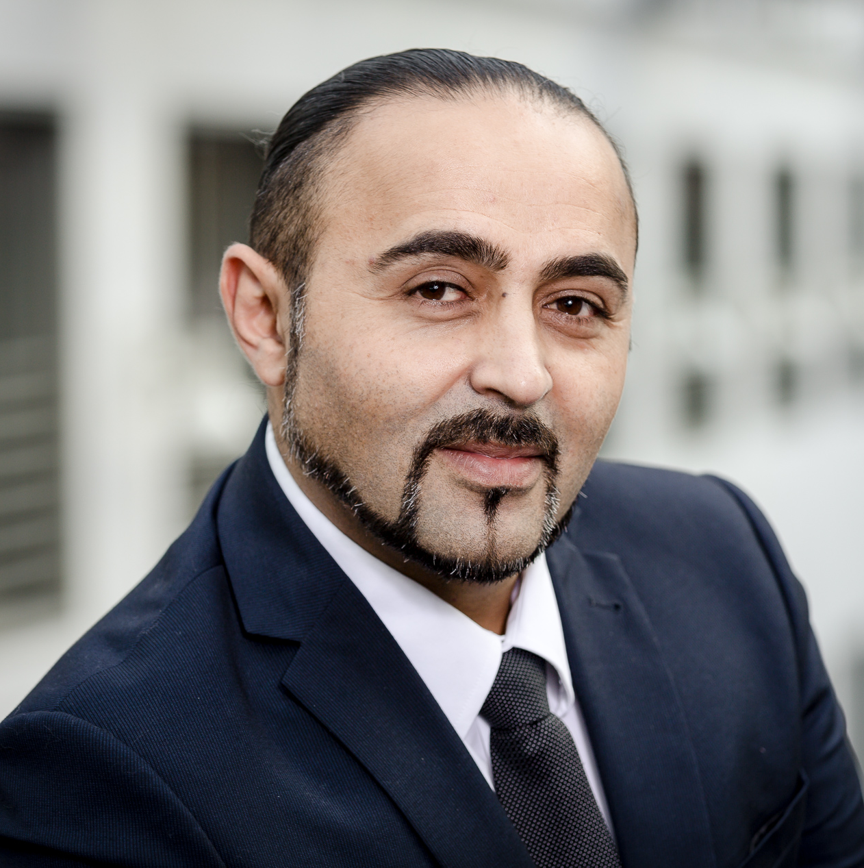
  Contact us—we look forward to hearing from you!
Ansprechpartner bitte anpassen
Kadim Tas
Name
Director
JOBLINGE umbrella organization
Eschersheimer Landstr. 10
60322 Frankfurt
Mobile. +49 176 3295 9989
kadim.tas@joblinge.de
Foto
Address
Phone: +49 XXXX
Mailaddress
Donation account: Recipient: JOBLINGE Stiftung | IBAN: DE68302201900016542466 | BIC: HYVEDEMM414
Please find further information on www.joblinge.de.

Slide 31
Appendix: Additional slides for use depending on the objective and audience
Dual vocational education and training system in Germany
Participation figures/statistics
Involvement for businesses and foundations
Organizational structure
Making a difference
Public presence

Slide 32
Dual vocational education and training system in Germany: A common path to work for young people
Approach and impact
~ 50% enter dual VET¹ system after school
Labour market
In-Company
training
(Practical component)
Vocational school education
(Theoretical component)
Dual VET system
Higher education
  Training under real-life working conditions and payment of "training allowance"
  In-company training standards defined in "training regulations"
  ~3-4 days training per week
  Financing through local government
  Lessons in professional and general education free of charge
  ~1-2 days of school per week
  Written and oral final exam
Main ways to enter the German labour market
2-3,5 years
3-6 years
General education
10-13 years
High employment security – Unemployment risk decreases to 25% for dual VET graduates
1. Vocational educational and training system
Theoretical training
Practical training

Slide 33




Overview: Dual VET system data and performance
Trainees
Employers
Government &
Society
On average 56% of the population enter Dual VET
1.4 m trainees in 327 recognized training occupations
More than 20% of all German companies train
~ 500,000 new trainees every year
investment of approx. 18,000€ per trainee per year
66% of trainees are hired as permanent afterwards
Government shares expenses for VET system with employers
~9,000 vocational training schools
Mandatory social security contributions partially paid by the employer
Statistics
Occupational proficiency and training in actual work environment
High employment security
Average training allowance of ~800€ per month and social security benefits
Certified access to variety of occupational opportunities
76% of investment is refinanced by productive contributions of trainees
Employers gain highly competent employees meeting the needs of the company
Same Dual VET qualification standards across Germany
Highly qualified workforce
Contribution to national labour market demand for qualified labour and strengthening of formalization of economy
Ability to efficiently steer VET system and assure its quality
Benefits
Dual VET system fosters comparatively low youth unemployment
and strong competiveness of German SMEs
Note: VET = Vocational educational and training system
Source: German Office for International Cooperation in Vocational Education and Training, BIBB Data Report, Federal Statistical Office
Notes:
Message
Slide provides impression about current „performance“ of Dual VET in Germany
Each stakeholder invests something but also gains something from Dual VET
55.7 % of an age cohort enters Dual VET, irrespective of the age in which Dual VET is started

Slide 34
Traditional: 75% of participants placed in apprenticeships
84% sustainability rate
As of Q4 2021
      Placement rate in the traditional program cumulative since 2008 in detail¹
      Placement and sustainability rate on an annual basis
Participants accepted
10,294
Placement rate² in %
Unable to continue
Due to move, parental leave, illness
Avg. 75%⁴
Still in program
Finished program
9,225
08/09
09/10
10/11
11/12
12/13
13/14
14/15
15/16
16/17
17/18
18/19
19/20
  Cancel: Behavior in violation of contract,
  lack of motivation
1,300
Sustainability³ in %
90
89
87
86
  No placement
75%
85
84
85
84
  Placement with support:
  e.g., EQ, volunteer year, training with support
80
79
78
74
Avg. 84%⁴
  Regular placement: primary labour market,
  on-the-job training, schooling,
  and further schooling
70
6,927
0
2008
2010
2012
2014
2016
2018
2020
1. Traditional program 2. New calculation basis: Leaving date per participant between Nov. 1 and Oct. 31 of the respective year (traditional program only) 3. Sustainability rate = number of participants who are still in their apprenticeship (or job) six months after starting, relative to the number of participants who started their apprenticeship/job more than six months ago 4. Weighted with the number of participants 5. Development by the end of 2019—reliable figure two years after beginning of program/group start

Slide 35
In which areas do participants complete their apprenticeships?
As of Q4 2021
Number of participants
100%
26%
19%
18%
9%
10%
8%
6%
4%
Placed in apprenticeship
Commercial services, goods trade, sales, hotel and tourism
Raw material extraction, production, and manufacturing
Health care, social work, training, and education
Corp. org., administration, accounting, and legal
Transport, logistics, protection, and security
Construction, architechture, surveying, building technology
Natural sciences, geography, and computer science
Other

Slide 36
JOBLINGE offers many opportunities for community involvement
Provide opportunities
Offer internships and/or apprenticeships and gain new junior employees
Try out new ways of recruiting and open up to new target groups
Get to know youths in practice: such as at workshops or in the STEM Worlds
Corporate volunteering
Directly work with the youths and/or support the organization
Social Days (on request)
Mentoring (one-on-one for six months)
Workshops about core competences for the youths, e.g., application training, financial training, social media, healthy diet
Pro bono support/consulting
Volunteer involvement as a member of the executive or supervisory board/networker
CSR offer
for companies and employees
Donations
Make the program, professional framework, and new projects possible
Single donations, e.g., for scholarships or tutoring offers or long-term, strategic partnership
Campaigns for company anniversaries, Christmas, birthdays ("donation instead of gift")
Together with customers or employees: Round up, extra-change initiative

Slide 37
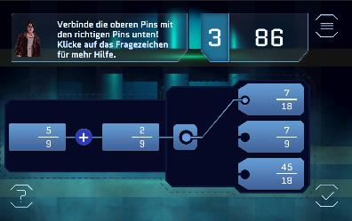
JOBLINGE can also offer options to (grant) foundations
  Proven concept for fulfilling the purpose of the foundation
  Locations all over Germany
  Experts who implement individual projects
  Contact with the target audience
  Network (businesses, public sector, organizations)
  Project execution
  Impact, reporting
Example: App/digitalization aimed at disadvantaged youths

Slide 38
JOBLINGE: A social franchise model
Entrepreneurial approach
National umbrella organization (franchiser)
  Nationwide steering and advancement of the initiative
  Legal form "e. V." (all gAGs and the Foundation are members of JOBLINGE e. V.)
Regional locations (franchisees)
  Implement the concept and work directly with the participants
  Local nonprofit corporations (gAG)
  Full-time team plus pro bono executive board and supervisory board
  JOBLINGE Foundation
  No operative activities
  Joint fundraising
JOBLINGE gAG
Munich
JOBLINGE gAG
Hanse
JOBLINGE gAG
Metropolitan region
Rhine-Neckar
JOBLINGE Foundation
JOBLINGE gAG
Berlin
Nonprofit
umbrella organization
(JOBLINGE e. V.)
JOBLINGE gAG
Rhineland
JOBLINGE gAG
Frankfurt
RhineMain
JOBLINGE gAG
Stuttgart region
JOBLINGE gAG
Leipzig
JOBLINGE gAG
Ruhr
Other future locations
Maximum impact and scale

Slide 39

The gAG XXXXXXXXXX: A strong network for youth
bitte einfügen, falls vorhanden
bitte einfügen
Pro bono director
Patron
Insert logo
Insert logo
Name
Name
Item
Item
Stockholders
bitte einfügen
Insert logo
Insert logo
Insert logo
Insert logo
Pro bono supervisory board of gAG XYZ
bitte einfügen/anpassen
Name
Name
Name
Name
Name
Name
Name
Insert logo
Insert logo
Insert logo
Insert logo
Insert logo
Insert logo
Insert logo
Item
Item
Item
Item
Item
Item
Item
Pro bono executive board
Chair of the supervisory board

Slide 40
Impact: Everybody wins
Youth
Real job opportunities and prospects
Sustainable integration into labour market and society
From benefits recipient to contributor ("The best thing
after the program? I can finally pay taxes")
Society
Closes the gap in the labour market and society
Prevention of long-term unemployment, including related costs/welfare benefits
Savings for each sustainably placed JOBLINGE participant after ten years: €140,000 (economic analysis by HessenChemie)
Businesses
Gain junior professionals and in the longterm, often very
loyal employees
Boosting employee retention and employer attractiveness:
Active community involvement, from board to trainee

Slide 41

Each participant with > €139K in socioeconomic savings after 10 years
++STICKER BITTE ENTFERNEN+++
Note: Erläuterungen zu den Zahlen finden sich in den Foliennotizen
      Cost comparison of JOBLINGE program with employment from a public-sector perspective¹
Balance in K€
JOBLINGE in general
After 10 years:
Balance of ~ €139,000²
10
After ~ 17 months:
Identical balances
Entry into occupation
Time in months
0
6
12
18
24
30
36
42
48
After 3.25 years:
Breakeven point for JOBLINGE
-10
-€12,920
-20
After ~ 6 months:
Max. negative balance of JOBLINGE
Unemployment in general
After 10 years:
Balance of ~ €70,000
-30
1. Source: Höpfer, R. (2015): "Die JOBLINGE-Initiative – eine volkswirtschaftliche Betrachtung" ["The JOBLINGE Initiative: An Economic Perspective"], in: Funk, R./Hummel, N. (Ed.): Tagungsband zu 11.Wiesbadener Gesprächen zur Sozialpolitik: "Gemeinsam gegen Jugendarbeitslosigkeit – Das Erfolgsmodell der JOBLINGE" [Proceedings of the 11th Wiesbaden Talks on Social Policy: "Joining Forces to Address Youth Unemployment: The Success Story of JOBLINGE" (FAZ Buch), pp.252–262. Note: Result of economic analysis by HessenChemie
2. Just earning (per capita) for public sector from tax and social insurance contributions—excl. long-term economic consumer and savings impact from each individual as well as
interest on capital
Notes:
++++++++++++++++++++++++++++++++++++++++++++++++++++++++++++++++++++++
€ 12.920
= (Pro-Kopf Kosten für die Ö-Hand FÜR und WÄHREND der Programmteilnahme) x (Pro-Kopf Erfolgsquote der erfolgreichen, langfristigen Integration in den Arbeitsmarkt)
= € 7.029 * 54,4%
>> Pro-Kopf Kosten für die Ö-Hand FÜR und WÄHREND der Programmteilnahme von €7.029:
Summe aus =
+ € 3.550 [Anteil der öffentlich geförderten Programmkosten pro Teilnehmer]
+ € 3.479 [Netto-Sozialleistungen für 6 Monate bei ALG II-Bezug]
>> Pro-Kopf Erfolgsquote der erfolgreichen, langfristigen Integration in den Arbeitsmarkt von 54,4%:
68% [Ǿ-Vermittlungsquote in 2015] x 80% [Ǿ-Nachhaltigkeitsquote in 2015]
+++++++++++++++++++++++++++++++++++++++++++++++++++++++++++++++++++++++
~ € 70.000 staatlicher pro-Kopf Ausgaben bei dauerhafter Arbeitslosigkeit von 10 Jahren = € 65.770
>> € 6.577 (p.a.) x 10 Jahren
>> € 6.577 ein Saldo aus:
+ Arbeitslosengeld II (p.a.): € 6.958 (= Regelleistung + Unterkunft und Heizung + Sozialleistungen)
Beitrag zur USt: €381 (90% Konsumquote bei 7,2% Ǿ-Umsatzsteuersatz)
+++++++++++++++++++++++++++++++++++++++++++
~139.000 € in 10 Jahren
(Saldo aus =)
+ öffentliche Ausgabe bei 6-monatiger JOBLINGE-Programmteilnahme: € -12.920
+ Nettobeitrag (= Ǿ-Bruttoeinkommen + Beitrag zur USt) während 3-jähriger Ausbildungszeit: 3 Jahre x € 4.719
+ Nettobeitrag bei 6,5 Jahren regulärer VZ-Beschäftigung nach erfolgreich abgeschlossener Ausbildung: 6,5 Jahre x € 21.198
++++++++++++++++++++++++++++++++++++++++++++++++++++++++++++++++++++

Slide 42













JOBLINGE in the public eye

Slide 43

























Slide 44
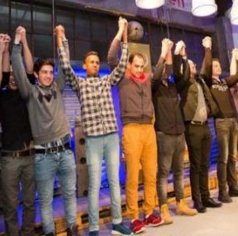
Join us: Courageously confronting resistance together
Quality: To aid those in the worst conditions with the best content, support, and personnel
Growth: To reach even more young people and continuously advance JOBLINGE
Transfer: Our experience from 10 years of JOBLINGE with the target group and well above average integration success
Reforms: In the labour market and transitional system between school and vocation
A big thank-you to all our partners, sponsors, and volunteers!
We look forward to many more dedicated personalities!

